Slide 1
The Band Theory of Solids
Dr. Md. Arzu Miah
Professor
Department of Chemistry
Jahangirnagar University
Savar, Dhaka-1342
Bangladesh
Cell: 01732150725.
Email: mamiah@gmail.com
mamiah@juniv.edu

Slide 2
What is Band Theory of Solids?
This theory explains the quantum state that an electron takes inside metal solid. Every molecule comprises of various discrete energy levels. The way electrons behave inside a molecule is well explained through this theory.
In atoms, electrons are filled in respective energy orbits following Pauli’s exclusion principle.
In molecules, Two atomic orbitals combine together to form a molecular orbital with two distinct energy levels.
In solids, 10²³ stacked up lines confined in a tiny space would look like a band. Thereby forming energy continuum called energy bands.
This theory helps to visualise the difference between conductor, semiconductor and an insulator by plotting available energies for an electron in a material.

Slide 3
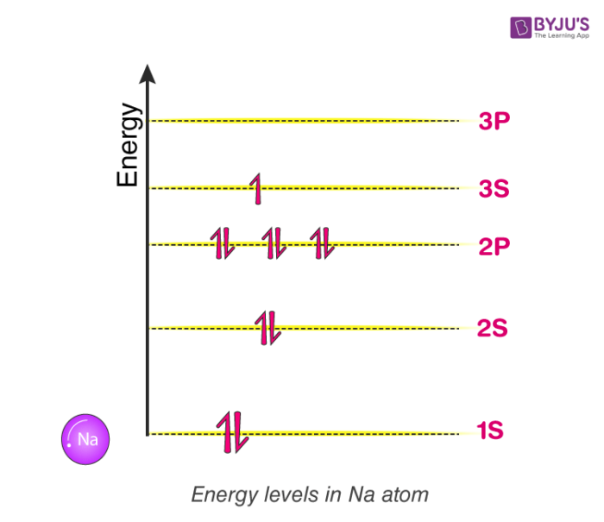
Energy Bands In Inside an atom
Consider a Sodium a atom. It comprises of 11 electrons. They fill up energy level following Pauli’s exclusion principle

Slide 4
Energy levels inside a molecule made up of two atoms
What happens when two sodium atoms very close to each other almost forming a molecule? Now each atom cannot have the configuration as it followed as an individual atom If they do they will be violating Pauli’s exclusion principle and end up with a lot of electrons of the same energy levels.
When two atoms come very close to each other, What is going to happen to this system? The answer is, their respective energy bands are going to overlap on each other and transform into what we call as Molecular orbital. That is the 1s orbit of individual Sodium atom combines to form 1s molecular orbital. As two atomic orbitals are overlapping, the molecular orbit ends up having two discrete energy levels. Where the Lower energy level is called bonding orbital and Higher energy level is called anti-bonding orbital. This will repeat for all orbits.

Slide 5
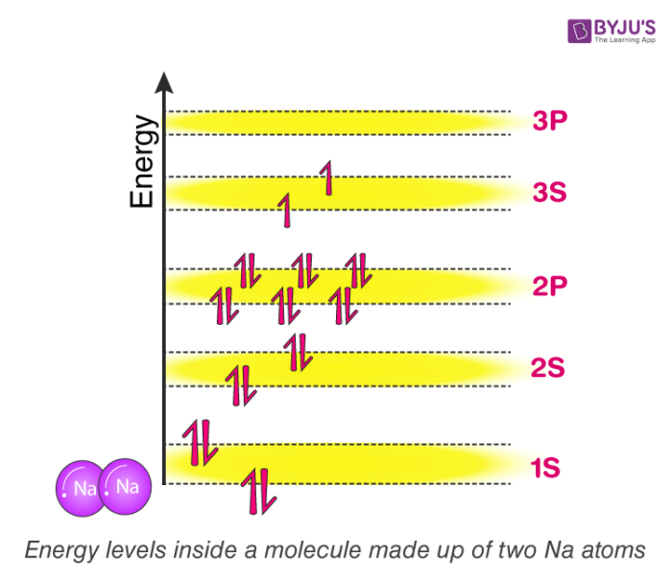

Slide 6
Energy levels inside a molecule made up of three atoms
Now try to picturise, what is going to happen if we add a third sodium atom to the mix? Well, according to the theory we learned just now. here three atomic orbitals will be overlapping forming single molecular orbital with three discrete energy levels. Each molecular orbital here will inherit three energy levels. In general, the more we add atoms, more energy levels the molecular orbit going to have.

Slide 7
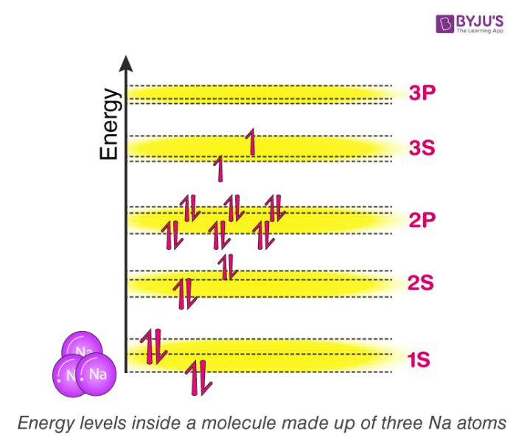

Slide 8
Energy levels inside a solid made up of Avogadro number of atoms
Eventually, if we have an entire solid, which is made of sodium with something like 10²³ atoms packed together, Each molecular orbital of this solid will have now 10²³ discrete energy levels. For better understanding purpose, Think about drawing 1s orbital of Sodium solid block, draw lower energy level and upper energy level and in between stack it with 10²³ energy levels! The gaps between them will be extremely small such that, no longer we can notice individual energy levels. As a result, It is convenient to think of it as continuous energy or energy continuum. When we think in this way, we can call them as energy band instead of molecular orbit.

Slide 9
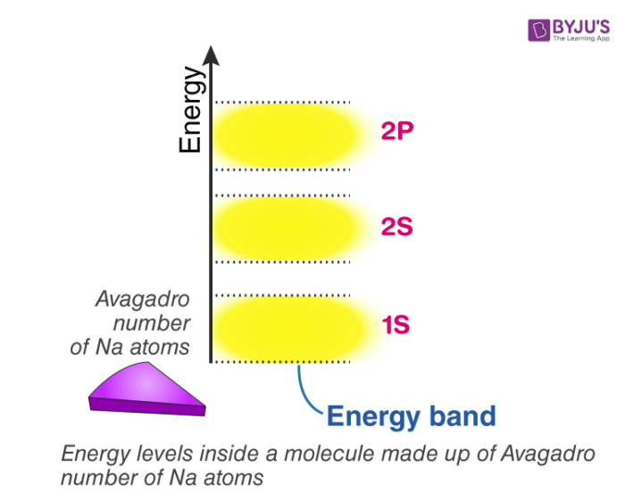

Slide 10
Energy levels inside a solid made up of n-number of atoms
In general, If there are n-number of atoms, then there will be n discrete energy levels in each energy band. In such a system of n number of atoms, the molecular orbitals are called as energy bands. Single 1s orbital and 2s orbital can fit 2 electrons each. thus, the total number of electrons a 1s and 2s energy band can fit is 2n. A single 2p level can fit 6 electrons so 2p energy band can fit is 6n electron so on and so forth.
As atoms come close to each other and eventually form a solid, They end up forming energy continuum and we name that continuum as bands. Within the bands, energy levels which are available are continuous. Thus, the name of this theory without any surprise is, “The band theory of solids”
Using this theory, we can understand how free electrons are generated and why certain material readily have free electron available making them a conductor and why some others don’t?

Slide 11
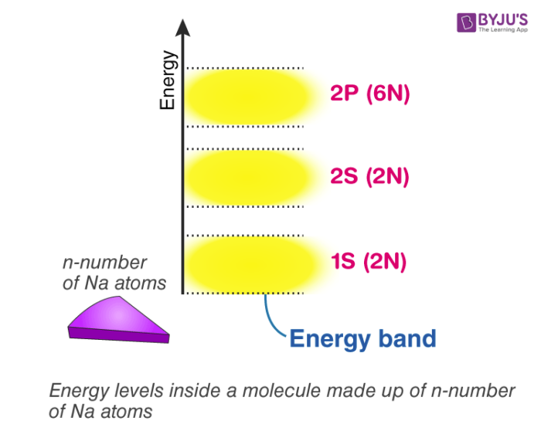

Slide 12
Atoms have been seen to have discrete energy levels.
When a huge number of atoms are combined to form a solid however, these discrete energy levels are replaced by discrete ranges of energy, or energy bands, within which there are so many individual allowed energy values that within the bands the distribution can be considered to be continuous. This idea is seen in the following figure:

Slide 13
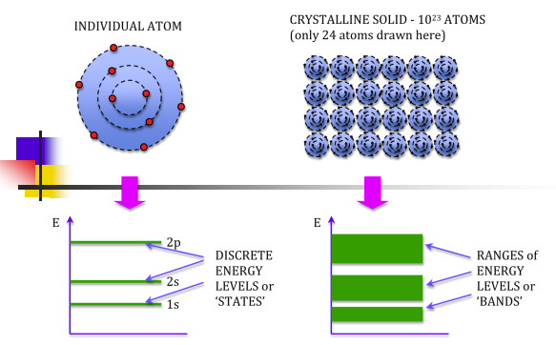

Slide 14
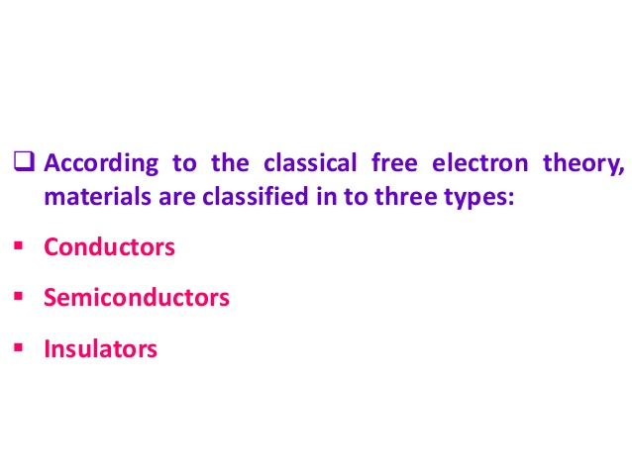

Slide 15
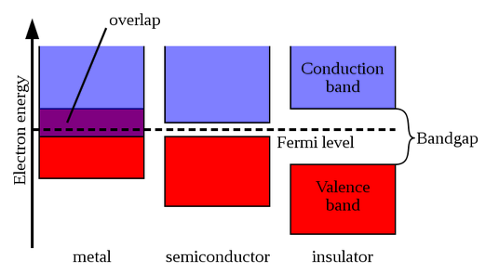

Slide 16
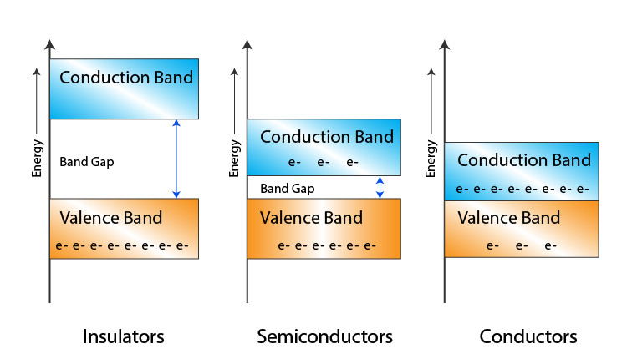

Slide 17
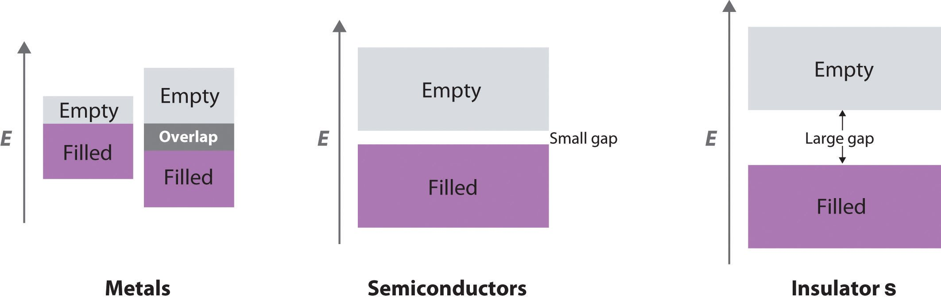

Slide 18
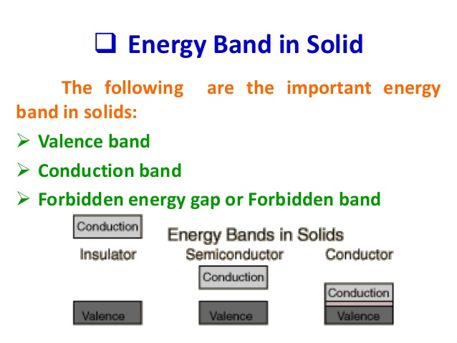

Slide 19
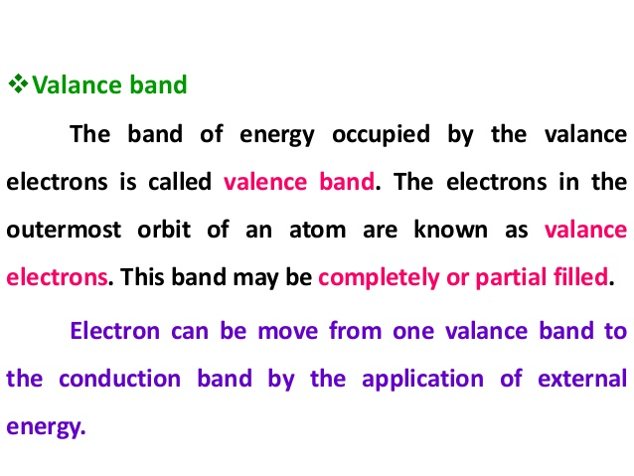

Slide 20
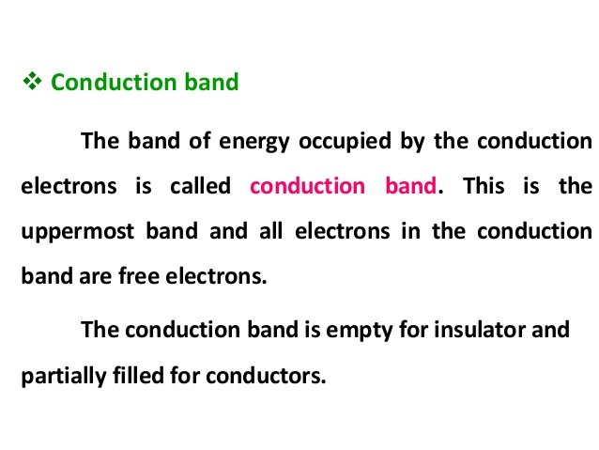

Slide 21
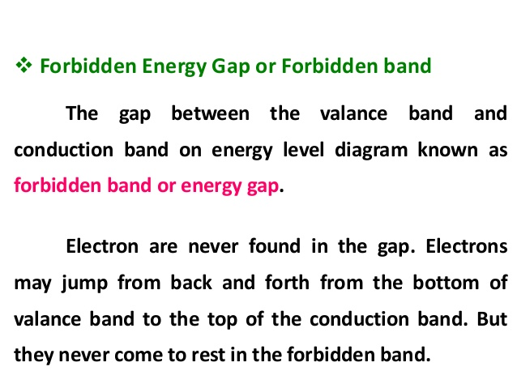

Slide 22
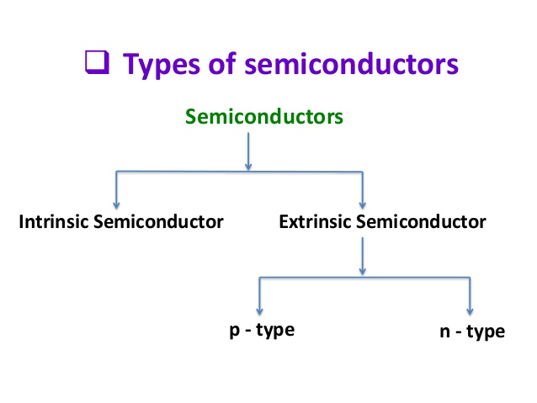

Slide 23
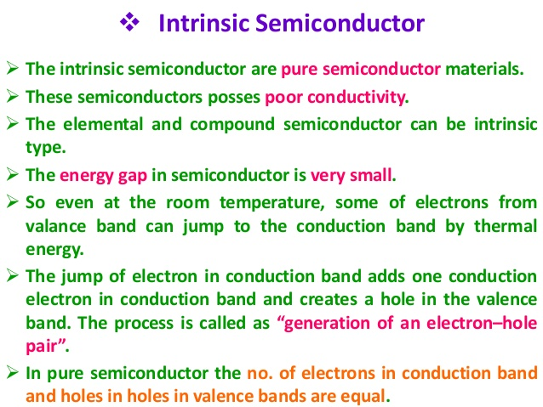

Slide 24
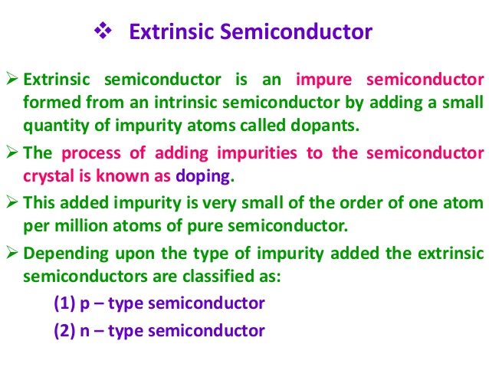

Slide 25
Difference between Intrinsic and Extrinsic Semiconductors
Intrinsic Semiconductor | Extrinsic Semiconductor
Pure semiconductor | Impure semiconductor
Density of electrons is equal to the density of holes | Density of electrons is not equal to the density of holes
Electrical conductivity is low | Electrical conductivity is high
Dependence on temperature only | Dependence on temperature as well as on the amount of impurity
No impurities | Trivalent impurity, pentavalent impurity

Slide 26
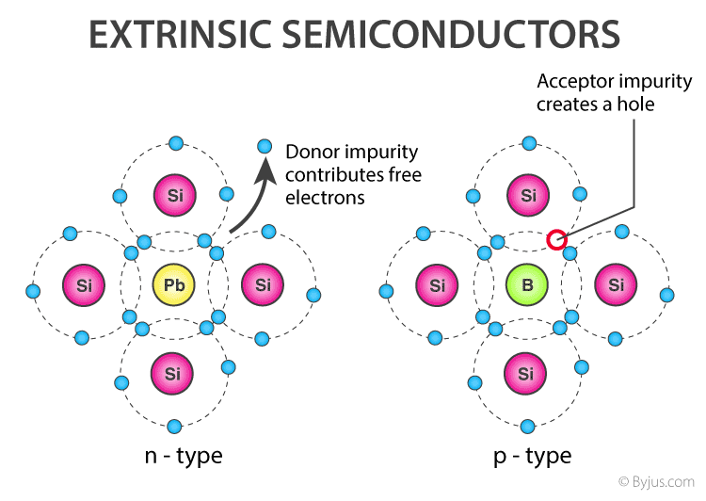

Slide 27
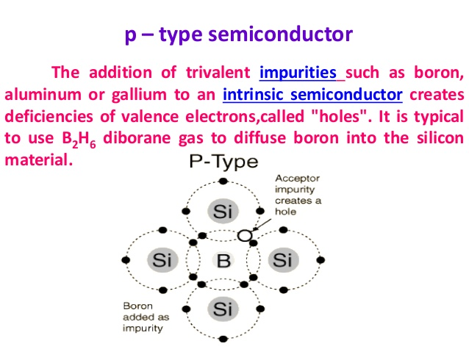

Slide 28
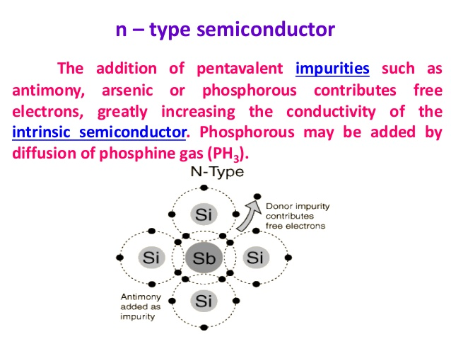

Slide 30
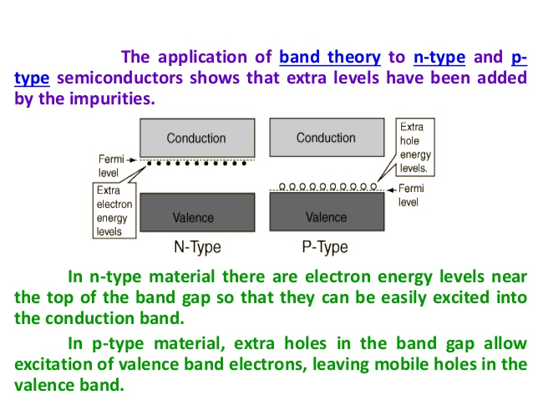

Slide 31
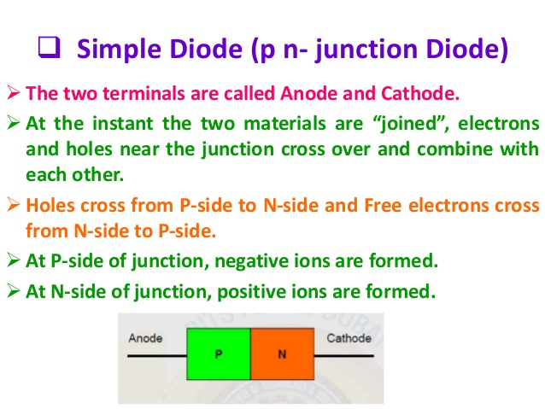

Slide 32
What is Fermi Energy?
Named after the Physicist, Enrico Fermi, a Fermi level is the measure of the energy of least tightly held electrons within a solid. It is important in determining the thermal and electrical properties of solids. It can be defined as:
The Fermi energy is a concept in quantum mechanics usually referring to the energy difference between the highest and lowest occupied single-particle states in a quantum system of non-interacting fermions at absolute zero temperature.
The value of the Fermi level at absolute zero temperature (−273.15 °C) is known as the Fermi energy.
It is also the maximum kinetic energy an electron can attain at 0K. Fermi energy is constant for each solid.

Slide 33
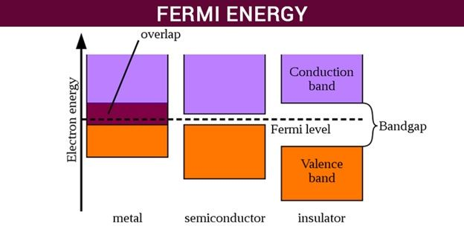
What is Fermi Level?

Slide 34
What is Quasi-fermi energy level?
Quasi-fermi energy level is defined as the change in the level of Fermi level as the charge carriers are added excessively to the semiconductor.

Slide 35
Value of Fermi energy for different elements
Element | Fermi Energy eV
Li | 4.74
K | 2.12
Na | 3.24
Cs | 1.59
Rb | 1.85
Ag | 5.49
Cu | 7.00
Be | 14.3
Au | 5.53
Ca | 4.69
Mg | 7.08
Ba | 3.64
Sr | 3.93
Fe | 11.1
Nb | 5.32
Zn | 9.47
Mn | 10.9
Hg | 7.13
Cd | 7.47
Al | 11.7
Ga | 10.4
In | 8.63
Tl | 8.15
Sn | 10.2
Pb | 9.47
Bi | 9.90
Sb | 10.9

Slide 36
Applications of Fermi Energy
It is one of the important concepts in quantum mechanics and condensed matter physics. Some fermi energy applications are given in the points below.
It is used in semiconductors and insulators.
It is used to describe insulators, metals, and semiconductors.
Fermi energy is applied in determining the electrical and thermal characteristics of the solids.
It is also important in nuclear physics to understand the stability of white dwarfs. White dwarfs are stars that have a mass comparable to the Sun but have about a hundredth of its radius.

Slide 37
Thanks a lot for patient hearing
The end

Slide 38
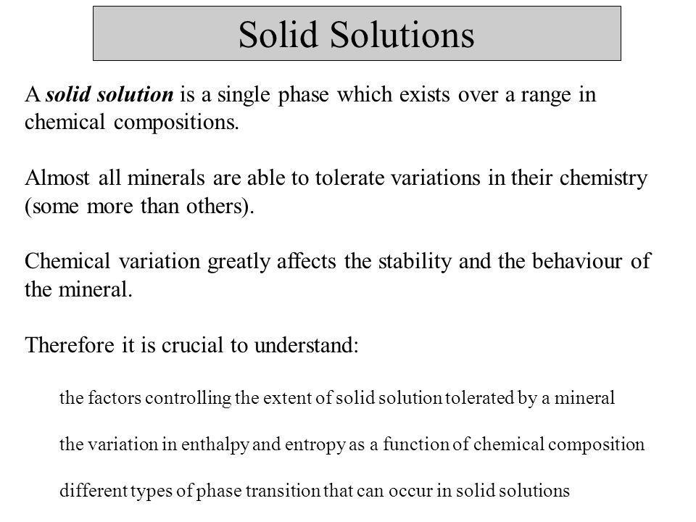

Slide 39
Difference Between Point Defect and Line Defect
The key difference between point defect and line defect is that the point defects occur only at or around a certain point of the crystal lattice whereas the line defects occur in a plane of atoms in the middle of the crystal lattice.

Slide 40
What is Point Defect?
Point defects are irregularities that occur at or around a single point of the crystal lattice. Typically, this type of defect forms either due to the presence of extra atoms or due to the loss of atoms from the lattice. Therefore, these defects are considerably small. However, sometimes there are some larger defects as well. We call them dislocation loops.

Slide 41
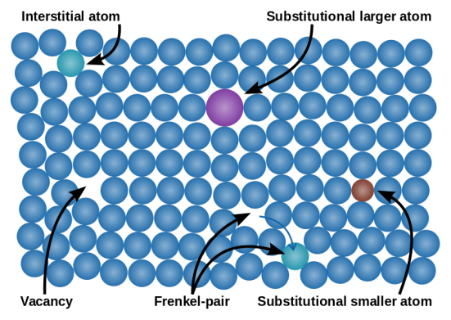

Slide 42
Several forms of point defects can occur in a crystal lattice.
Vacancy defects
Interstitial defects
Frenkel defects
Substitutional defects
Schottky defect

Slide 43
What is Line Defect?
Line defects are a form of crystallographic defects in which the defects occur in a plane of atoms in the middle of the crystal lattice. Therefore, these are linear defects. There the atoms of the lattice are misaligned. The two major forms of these defects are;
Edge dislocation
Screw dislocation

Slide 44
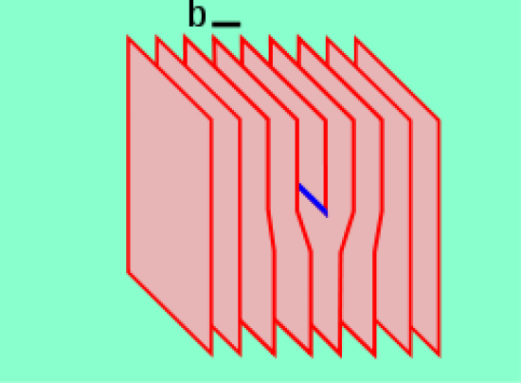
Edge Dislocation

Slide 45
IMPERFECTIONS IN SOLIDS
• What types of defects arise in solids?
Can the number and type of defects be varied
and controlled?
How do defects affect material properties?
Are defects undesirable?
How do point defects in ceramics differ from those
in metals?
In ceramics, how are impurities accommodated
in the lattice and how do they affect properties?
1

Slide 46
TYPES OF IMPERFECTIONS
• Vacancy atoms
• Interstitial atoms
• Substitutional atoms
Point defects
Line defects
Area defects
• Dislocations
• Grain Boundaries
2

Slide 47
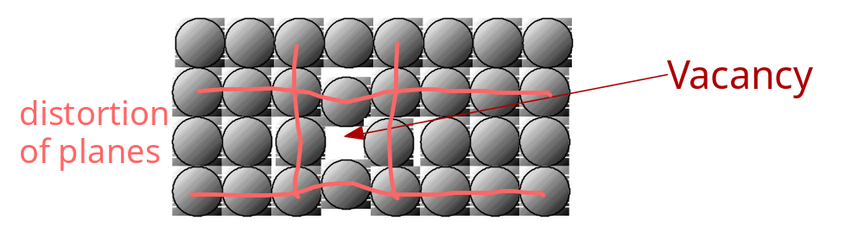
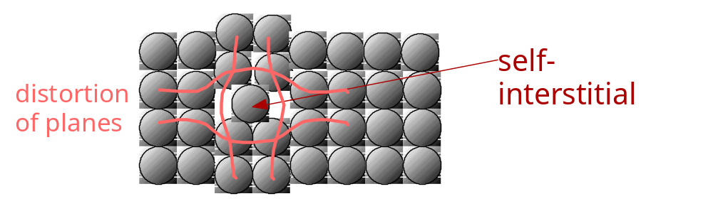
POINT DEFECTS
• Vacancies:
-vacant atomic sites in a structure.
• Self-Interstitials:
-"extra" atoms positioned between atomic sites.
3

Slide 49
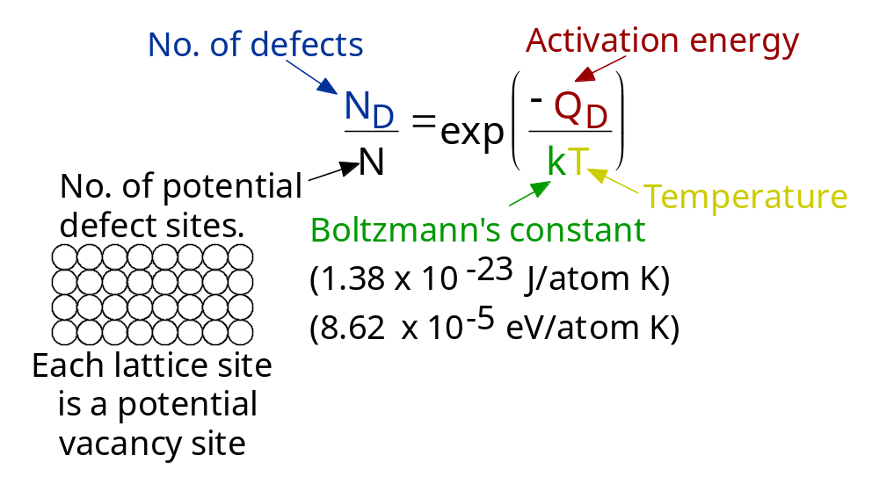
EQUIL. CONCENTRATION:
POINT DEFECTS
• Equilibrium concentration varies with temperature!
4

Slide 50
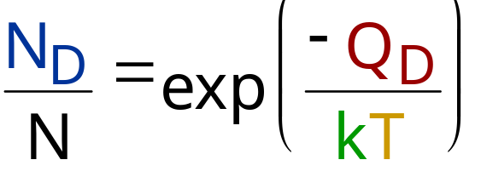
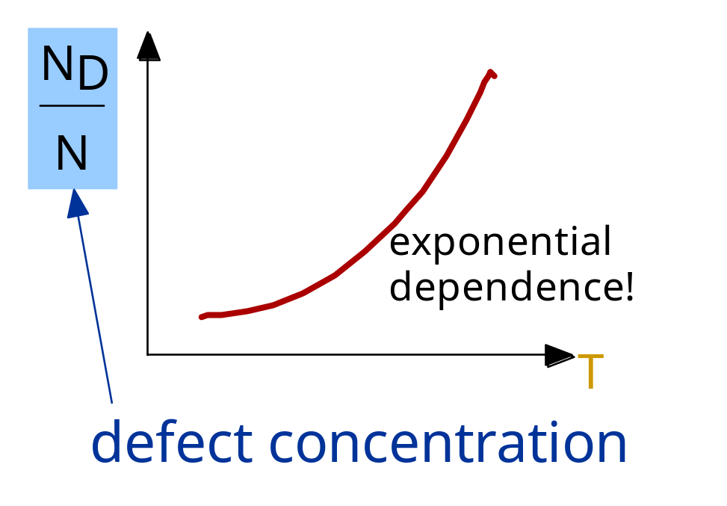
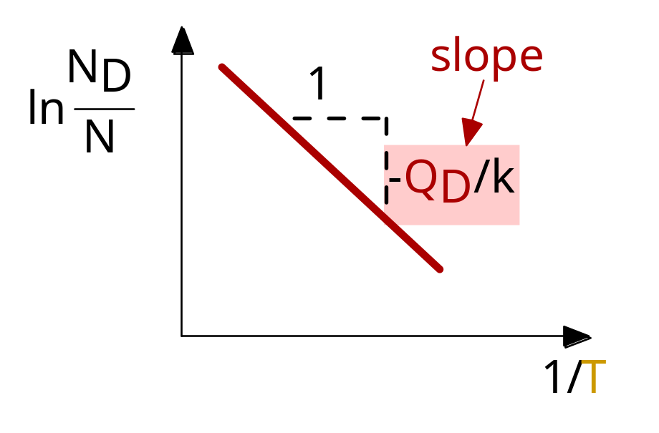
MEASURING ACTIVATION ENERGY
• We can get Q from
an experiment.
• Measure this...
• Replot it...
5

Slide 51
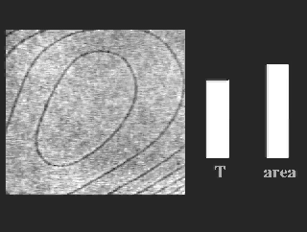
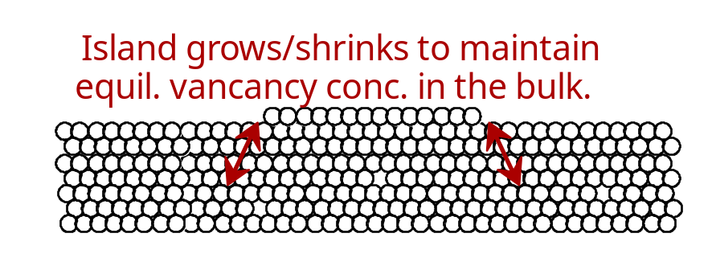
OBSERVING EQUIL. VACANCY CONC.
• Low energy electron
microscope view of
a (110) surface of NiAl.
• Increasing T causes
surface island of
atoms to grow.
• Why? The equil. vacancy
conc. increases via atom
motion from the crystal
to the surface, where
they join the island.
Click on image to animate
7

Slide 52
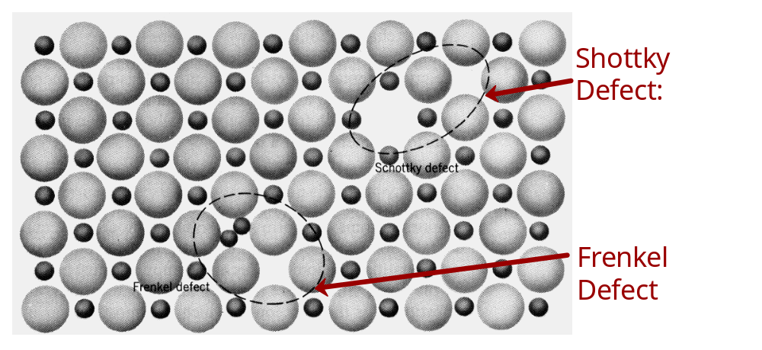

DEFECTS IN CERAMIC STRUCTURES
• Frenkel Defect
--a cation is out of place.
• Shottky Defect
--a paired set of cation and anion vacancies.
• Equilibrium concentration of defects
8

Slide 53
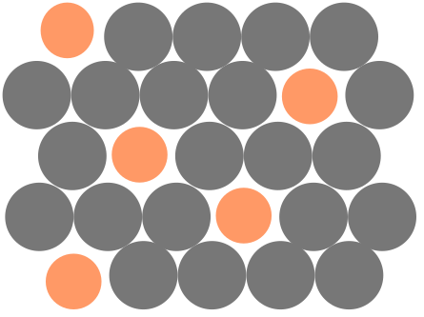
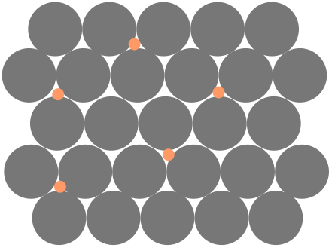
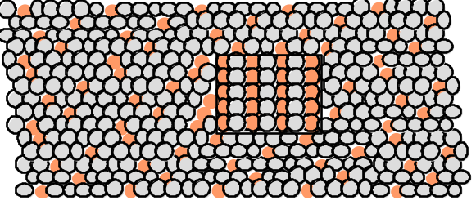
POINT DEFECTS IN ALLOYS
Two outcomes if impurity (B) added to host (A):
• Solid solution of B in A (i.e., random dist. of point defects)
OR
Substitutional alloy
(e.g., Cu in Ni)
Interstitial alloy
(e.g., C in Fe)
• Solid solution of B in A plus particles of a new
phase (usually for a larger amount of B)
Second phase particle
--different composition
--often different structure.
9

Slide 54
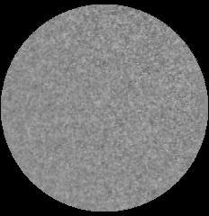
ALLOYING A SURFACE
• Low energy electron
microscope view of
a (111) surface of Cu.
• Sn islands move along
the surface and "alloy"
the Cu with Sn atoms,
to make "bronze".
• The islands continually
move into "unalloyed"
regions and leave tiny
bronze particles in
their wake.
• Eventually, the islands
disappear.
10

Slide 55

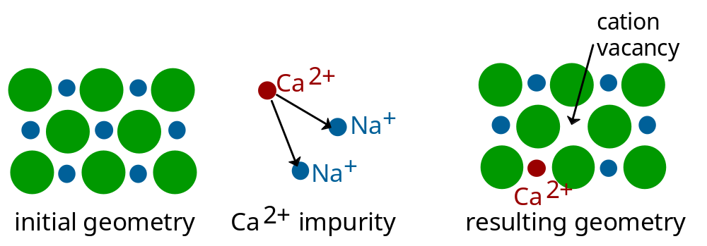
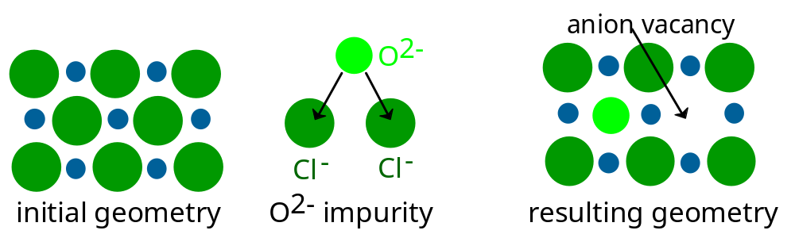
IMPURITIES
• Impurities must also satisfy charge balance
• Ex: NaCl
• Substitutional cation impurity
• Substitutional anion impurity
11

Slide 56
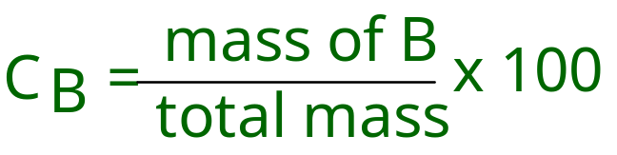
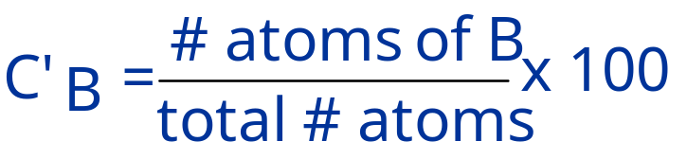
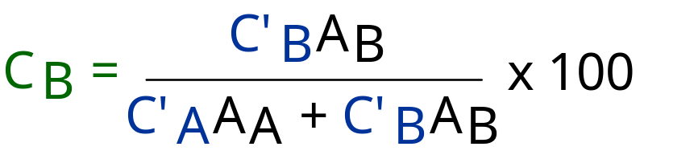
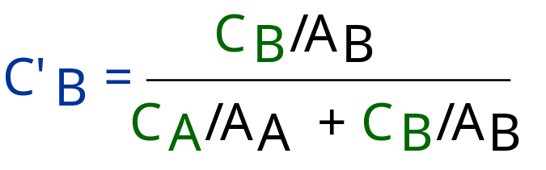
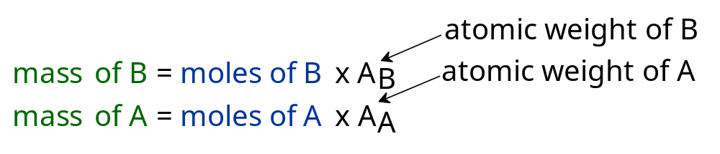
COMPOSITION
Definition: Amount of impurity (B) and host (A)
in the system.
Two descriptions:
• Weight %
• Atom %
• Conversion between wt % and at% in an A-B alloy:
• Basis for conversion:
12

Slide 57
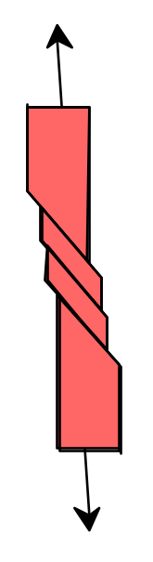

LINE DEFECTS
Dislocations:
• are line defects,
• cause slip between crystal plane when they move,
• produce permanent (plastic) deformation.
Schematic of a Zinc (HCP):
• before deformation
• after tensile elongation
slip steps
13

Slide 58
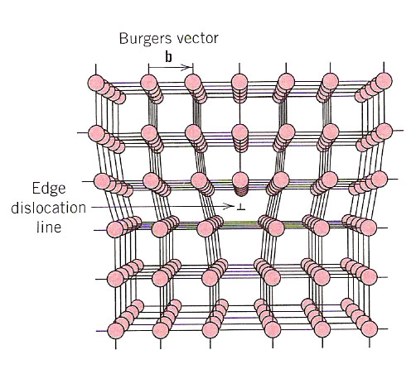
Edge Dislocation
An edge dislocation results from a mismatch in the rows of atoms, as if an extra plane of atoms was inserted.
The burger’s vector, b, represents how far we would have to move an atom to bring it back into registry. The burgers vector is perpendicular to the dislocation line.

Slide 59
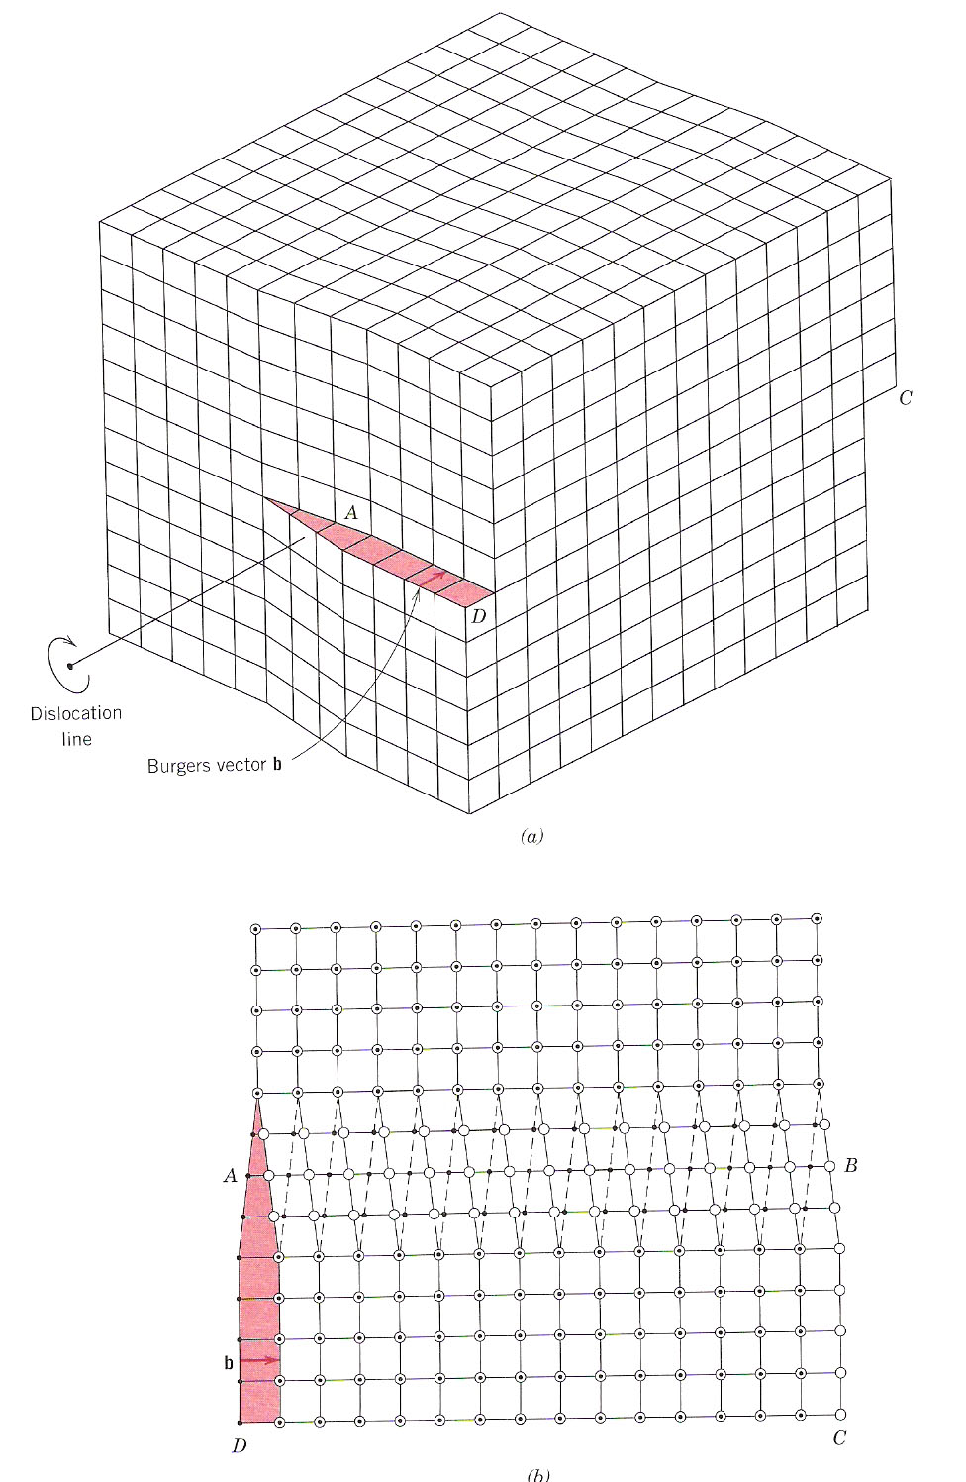
Screw Dislocation
Screw dislocations result from “shearing” in the crystal. The burgers vector, b, is parallel to the slip plane

Slide 60
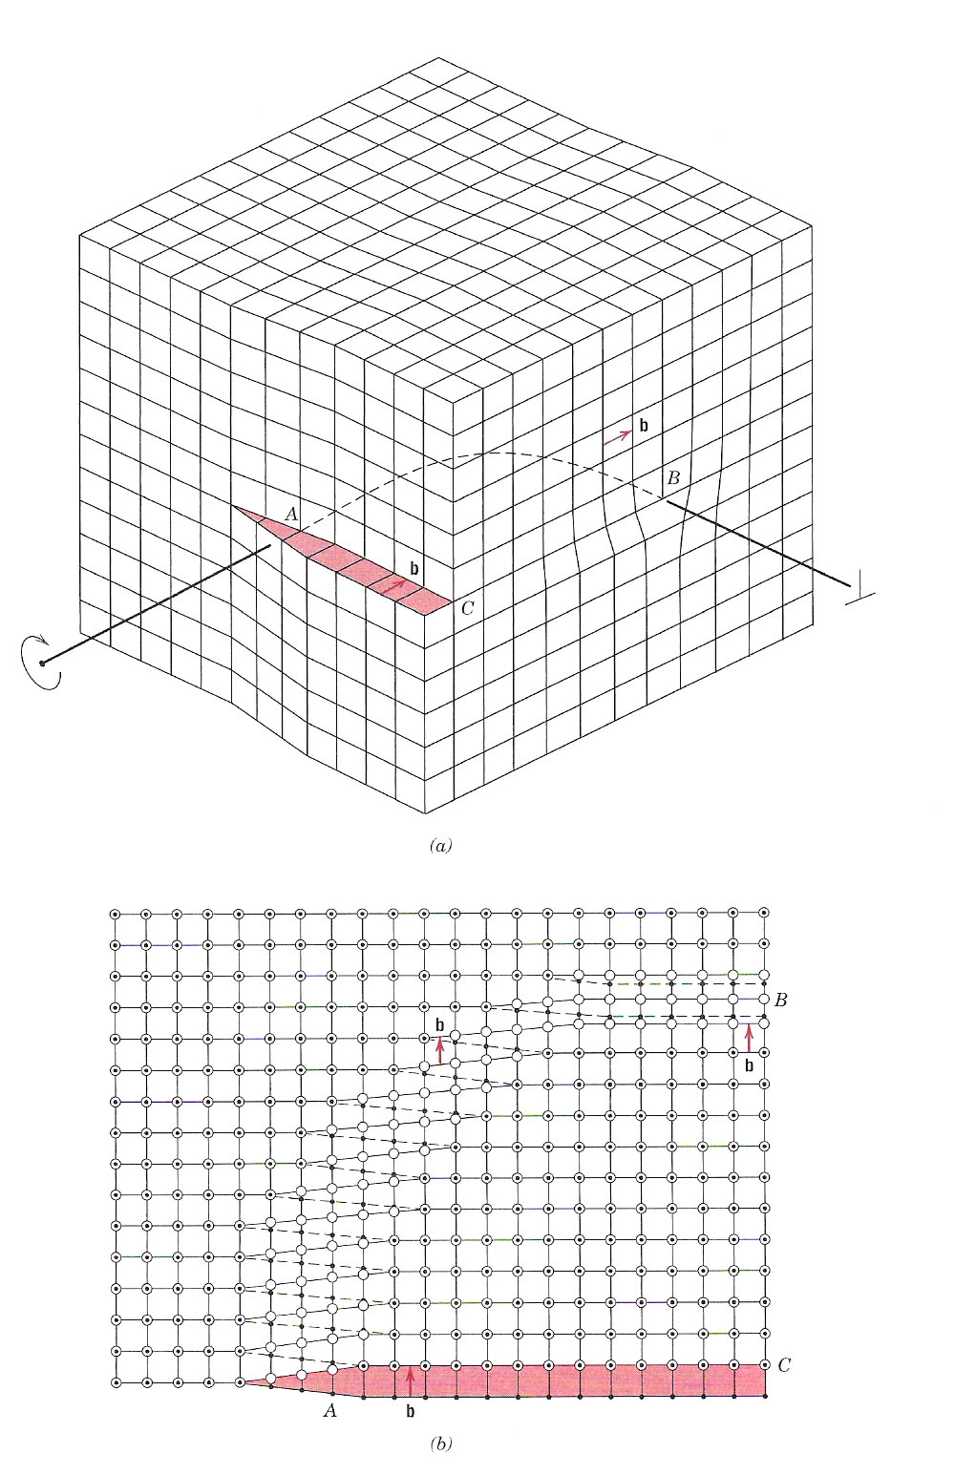
Mixed Dislocation
Dislocations virtually never are purely “edge” or “screw” type.
They are usually combinations of the two, or “mixed”

Slide 61

BOND BREAKING AND REMAKING
• Dislocation motion requires the successive bumping
of a half plane of atoms (from left to right here).
• Bonds across the slipping planes are broken and
remade in succession.
Atomic view of edge
dislocation motion from
left to right as a crystal
is sheared.
Click on image to animate
15

Slide 62


AREA DEFECTS: GRAIN BOUNDARIES
Grain boundaries:
• are boundaries between crystals.
• are produced by the solidification process, for example.
• have a change in crystal orientation across them.
• impede dislocation motion.
Metal Ingot
Schematic
~ 8cm
Adapted from Fig. 4.7, Callister 6e.
16

Slide 63

Low angle grain boundary
Low angle grain boundaries are made up of equally spaced dislocation to accommodate the mismatch in lattices between two grains

Slide 64

Volume Defects - twins
Twins occur when atoms jump from one site to a “mirror” site
Twins can occur because of thermal treatment (annealing twins) or mechanical deformation
{
Plane jumps to mirror image

Slide 65

Hume-Rothery rules for substitutional solids
Consider Cu and Ni:
r_{Cu}=0.128 nm
r_{Ni}=0.125 nm
Size difference: 2.3%
Both FCC
Cu & Ni electronegativity: 1.9 and 1.8, respectively
Valence:
Cu: 2
Ni: 2,3
Atomic sizes agree within 15%
Same crystal structure
Similar electronegativity
Similar valence

Slide 66

OPTICAL MICROSCOPY (1)
• Useful up to 2000X magnification.
• Polishing removes surface features (e.g., scratches)
• Etching changes reflectance, depending on crystal
orientation.
close-packed planes
Adapted from Fig. 4.11(b) and (c), Callister 6e. (Fig. 4.11(c) is courtesy
of J.E. Burke, General Electric Co.
micrograph of
Brass (Cu and Zn)
0.75mm
17

Slide 67


OPTICAL MICROSCOPY (2)
Grain boundaries...
• are imperfections,
• are more susceptible
to etching,
• may be revealed as
dark lines,
• change direction in a
polycrystal.
18

Slide 68


SCANNING TUNNELING MICROSCOPY
• Atoms can be arranged and imaged!
Carbon monoxide molecules arranged on a platinum (111) surface.
Iron atoms arranged on a copper (111) surface. These Kanji characters represent the word “atom”.
19

Slide 69
SUMMARY
• Point, Line, and Area defects arise in solids.
• The number and type of defects can be varied
and controlled (e.g., T controls vacancy conc.)
• Defects affect material properties (e.g., grain
boundaries control crystal slip).
• Defects may be desirable or undesirable
(e.g., dislocations may be good or bad, depending
on whether plastic deformation is desirable or not.)
20

